Slide 1
SOLID
Tien Nguyen

Slide 2
Contents
OOP principles
Abstraction
Encapsulation
Inherritance
Polymorphism
SOLID
Single Responsibility Principle (SRP)
Open-Closed Principle (OCP)
Liskov Substitution Principle (LSP)
Interface Segregation Principle (ISP)
Dependency Inversion Principle (DIP)

Slide 3
OOP principles
Abstraction:
Focus on a system's essential elements
Ignore the less important details that have no effect on its key features.

Slide 4
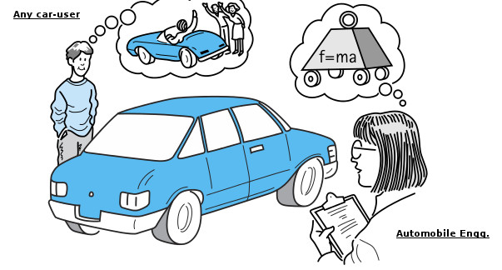
OOP principles
Abstraction:

Slide 5
OOP principles
Encapsulation :
Refers to the combining of data and code into a single object
Only object’s methods may then directly access and make changes to the object’s data.

Slide 6
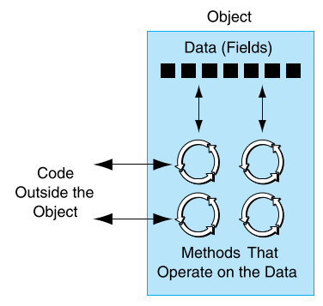
OOP principles
Encapsulation :

Slide 7
OOP principles
Inherritance:
Enables a class to inherit the attributes and methods of another class.
Provides the ability to create new classes by abstracting out common attributes and behaviors from another class.

Slide 8
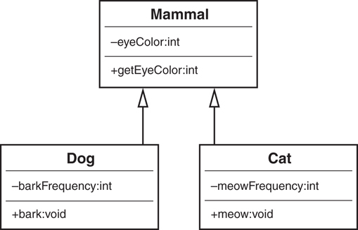
OOP principles
Inherritance:

Slide 9
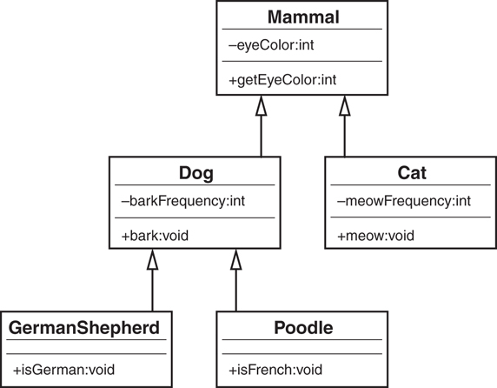
OOP principles
Inherritance:

Slide 10
OOP principles
Polymorphism:
The ability to take many forms
Usually coupled into inheritance
Provide standardization for the interface across classes, as well as applications

Slide 11
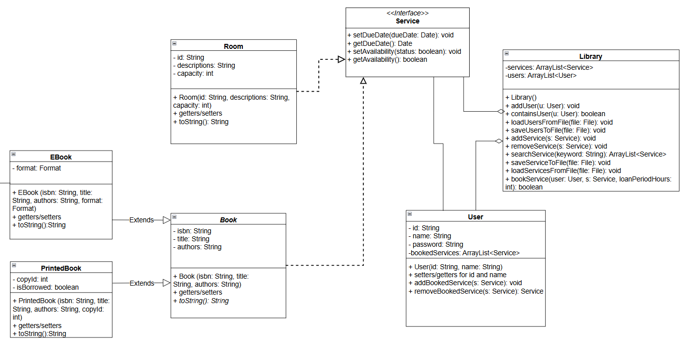
OOP principles
Polymorphism:

Slide 12
Refactoring code smells
Duplicate code
Long method
Large class
Temporary field
Switch statements
Parallel inheritance hierarchies

Slide 13
Refactoring code smells
Duplicate code
One of the most commonly recognized code smells
Identical or very similar blocks of code appear in multiple places within a codebase
Examples:
UserService.java
RefactorUserService.java

Slide 14
Refactoring code smells
Duplicate code
One of the most commonly recognized code smells
Identical or very similar blocks of code appear in multiple places within a codebase
Examples:
UserService.java
RefactorUserService.java

Slide 15
Refactoring code smells
Long method
A method is trying to do too much
Makes the code harder to read, maintain, and test.
Examples:
LongMethod.java
RefactoredLongMethod.java

Slide 16
Refactoring code smells
Large class:
Typically have too many instance variables, methods, or responsibilities
Harder to understand, maintain, and extend
Examples:
OrderProcessor.java
RefactorOderClasses.java

Slide 17
Refactoring code smells
Temporary field:
When a class has instance variables (fields) that are only occasionally used or have values that are meaningful only in specific situations
Unnecessarily occupy memory, complicate the class design, and often violate the Single Responsibility Principle (SRP)
Example:

Slide 18
Refactoring code smells
Switch statements by example:
public double calculateArea(Shape shape) {
switch (shape.getType()) {
case "Circle":
return Math.PI * shape.getRadius() * shape.getRadius();
case "Rectangle":
return shape.getWidth() * shape.getHeight();
default:
throw new IllegalArgumentException("Unknown shape type");
}
}

Slide 19
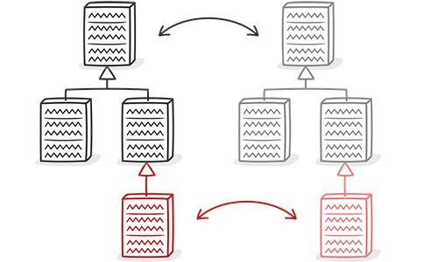
Refactoring code smells
Parallel inheritance hierarchies
Source: Parallel Inheritance Hierarchies

Slide 20
Design smells
Rigidity
Software is difficult to change
Fragility
Program breaks in many places when a change made in a single place
Immobility
Parts could be useful in other systems, but effort and risk to separate from original system is too great

Slide 21
Design smells
Viscosity
Design-preserving methods are more difficult to use than the hacks
Development environment is slow and inefficient
Needless complexity
Contains elements that aren’t currently useful
Needless repetition
System has lots of repeated code elements
Opacity
A module is difficult to understand

Slide 22
Why does software rot?
Waterfall methodology
Requirements change
Code wants to be chaotic
We don’t take time to refactor
We suck at OO design
Designs and practices are at fault

Slide 23
Technical Debt
The cost to fix rotting code
Interest charges build over time
The longer we take to remove the smells, the more it will cost

Slide 24
Company A offers shipping service. To create an order, users must input the sender’s name and phone number, receiver’s name and phone number, and select the shipping types including standard and fast shipping. The cost for each types are different. Cost of the standard service is 5 + 2*the item’s weight, cost of the fast service is 10 + 2.5*the item’s weight. The company usually offers the ability to set discounts (can be fixed, percentage discount or no discount).
Design classes for the problem

Slide 25
Design classes for hotel booking management system. The system should allow users to input location, checkin, checkout date to find appropriate hotels, then view the hotel room list, select one room, view room types (suite or single which has different price per night), services included, reviews about that room and make a booking for that room.

Slide 26
SOLID
Adhere to the SOLID principles to prevent problems and keep code flexible, maintainable, and easy to modify

Slide 27
SOLID
Single Responsibility Principle (SRP):A class should have only one reason to change, meaning it should only have one responsibility or job.

Slide 28
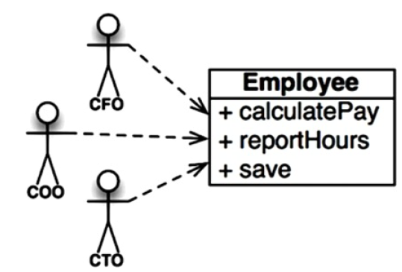
SOLID
Single Responsibility Principle (SRP):

Slide 29

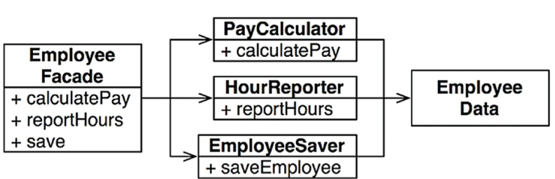
SOLID
Single Responsibility Principle (SRP):

Slide 30
SOLID
Open/Closed Principle (OCP): Software entities (classes, modules, functions, etc.) should be open for extension but closed for modification.
In other words, the behavior of a software artifact ought to be extendible, without having to modify that artifact.

Slide 31
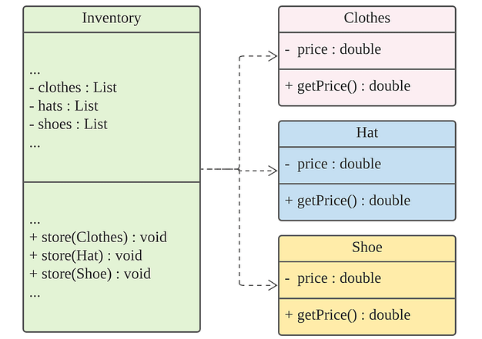

SOLID
Open/Closed Principle (OCP):
Source: What is Open-Closed Principle?. Definition of OCP, violation, benefits | by Jun Bang | Medium

Slide 32
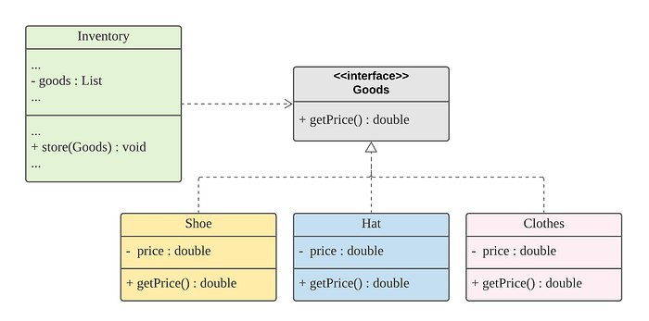

SOLID
Open/Closed Principle (OCP):
Source: What is Open-Closed Principle?. Definition of OCP, violation, benefits | by Jun Bang | Medium

Slide 33
SOLID
Liskov Substitution Principle (LSP): Objects of a superclass should be replaceable with objects of a subclass without affecting the correctness of the program.

Slide 34
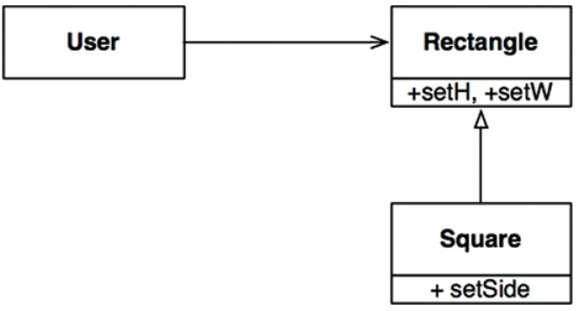
SOLID
Liskov Substitution Principle (LSP):

Slide 35
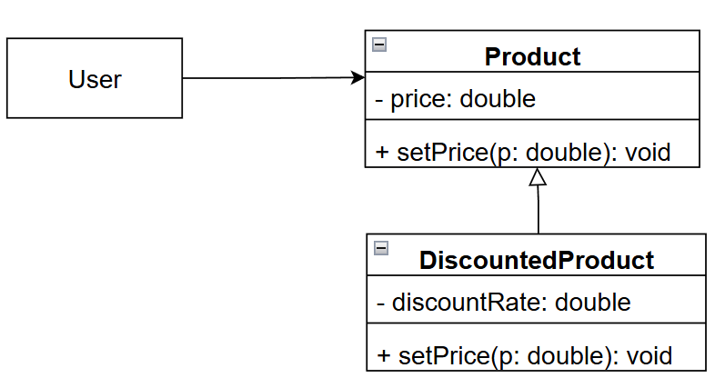
SOLID
Liskov Substitution Principle (LSP):

Slide 36
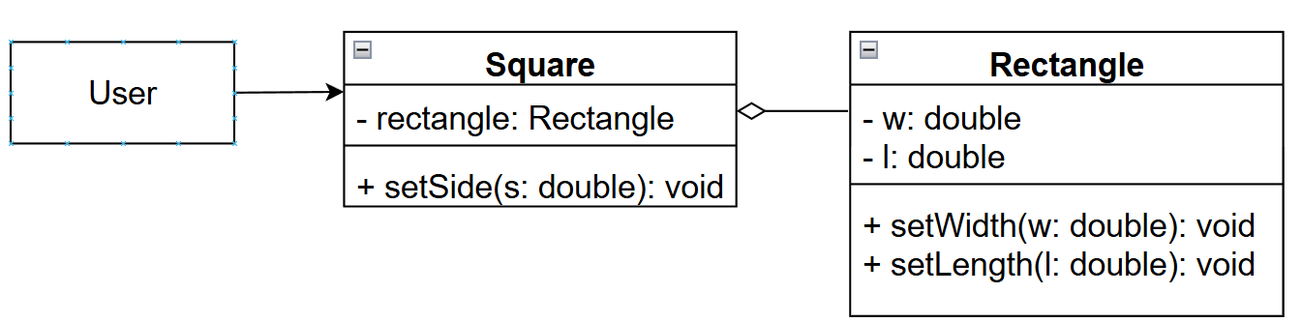
SOLID
Liskov Substitution Principle (LSP):
Possible solution: Prefer composition over inheritance when wanting to reuse code

Slide 37
SOLID
Interface Segregation Principle (ISP):
A client should not be forced to implement interfaces it doesn't use.
Instead of one large interface, multiple smaller interfaces are preferable.

Slide 38
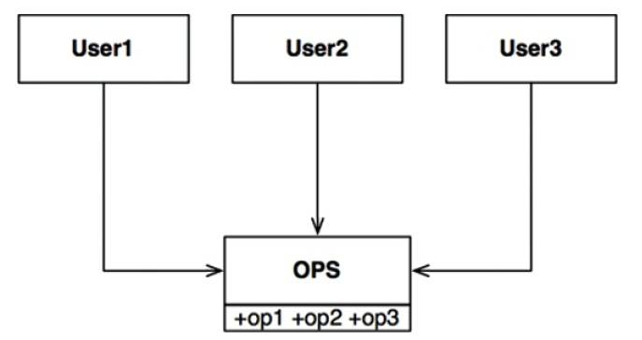
SOLID
Interface Segregation Principle (ISP):

Slide 39
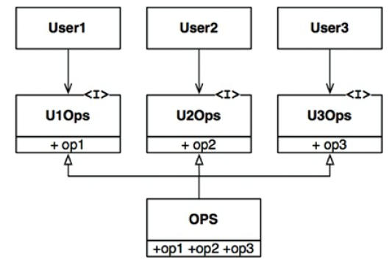
SOLID
Interface Segregation Principle (ISP):

Slide 40
SOLID
Dependency Inversion Principle (DIP):
High-level modules should not depend on low-level modules.
Both should depend on abstractions.
Abstractions should not depend on details.
Details should depend on abstractions.

Slide 41
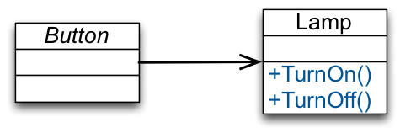
SOLID
Dependency Inversion Principle (DIP):
stg-tud.github.io/sedc/Lecture/ws13-14/3.5-DIP.html

Slide 42
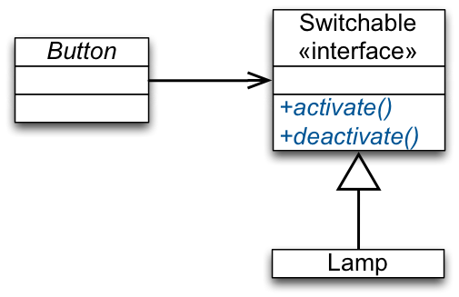
SOLID
Dependency Inversion Principle (DIP):
stg-tud.github.io/sedc/Lecture/ws13-14/3.5-DIP.html

